Slide 1
Programming of smart device components
Asistentas : Simonas Česnauskas

Slide 2
Connection of the resistors
In electronics, there are two ways in which components can be connected, that is, in parallel or in series. A third, mixed combination of components can also be distinguished. When in a circuit the components are connected both in parallel and in series.
Depending on the way the resistors are connected, the final resistance and capacity of the circuit vary.

Slide 3
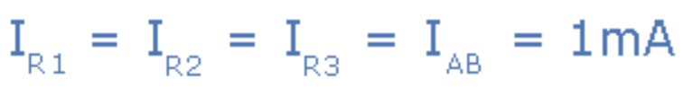
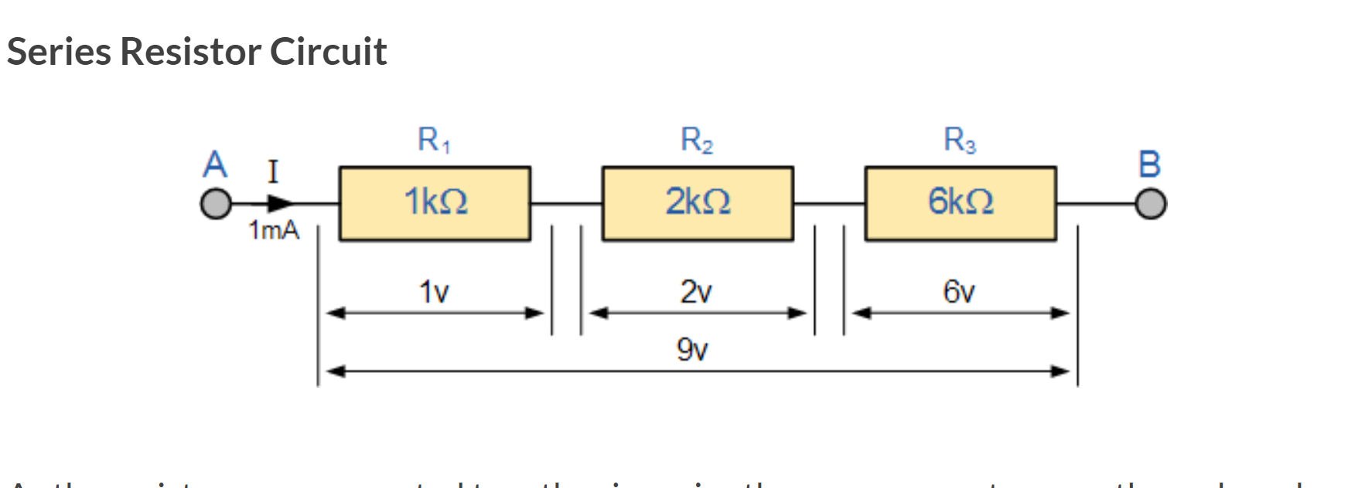
Resistors in series
Connecting resistors in series means that all resistors are connected in a straight circuit one after the other.
Since they are connected one after the other, the current entering the first resistor of the circuit has no choice but to flow further to the second, then the third, and so on.
This means that the same current flows through the entire resistor circuit.

Slide 4

Resistors in series
A series of resistors connected in series can be thought of as a single resistor with a resistance equal to the sum of the resistances of all the resistors in the circuit.

Slide 5
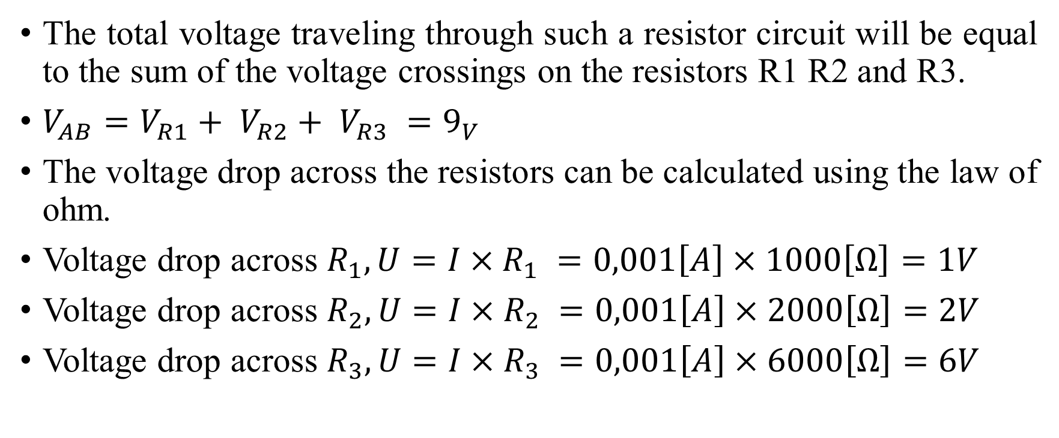
Resistors in series
The total voltage traveling through such a resistor circuit will be equal to the sum of the voltage crossings on the resistors R1 R2 and R3.
$V_{AB}=V_{R1}+ V_{R2}+ V_{R3} =9_{V}$
The voltage drop across the resistors can be calculated using the law of ohm.
Voltage drop across $R_{1},U=I×R_{1} =0,001\left[A\right]×1000\left[Ω\right]=1V$
Voltage drop across $R_{2},U=I×R_{2} =0,001\left[A\right]×2000\left[Ω\right]=2V$
Voltage drop across $R_{3}, U=I×R_{3} =0,001\left[A\right]×6000\left[Ω\right]=6V$

Slide 6
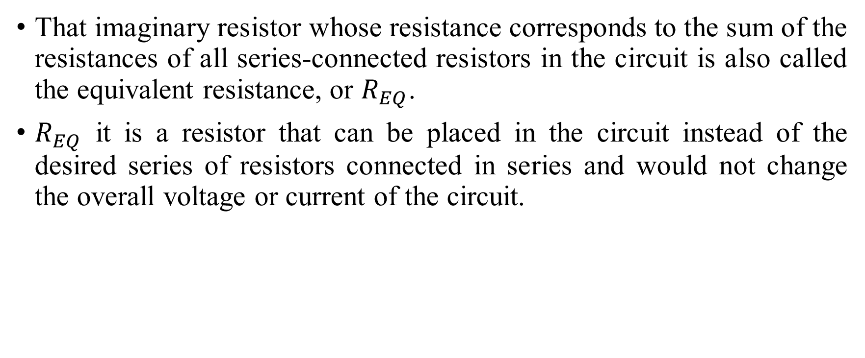
Resistors in series
That imaginary resistor whose resistance corresponds to the sum of the resistances of all series-connected resistors in the circuit is also called the equivalent resistance, or $R_{EQ}$.
$R_{EQ}$ it is a resistor that can be placed in the circuit instead of the desired series of resistors connected in series and would not change the overall voltage or current of the circuit.

Slide 7
Resistance formula for resistors connected in series
$$R_{EQ}= R_{1}+ R_{2}+ R_{3}+ <…> + R_{n}$$

Slide 8
Voltage formula for resistors connected in series
$$V_{source} = V_{R1}+ V_{R2}+ V_{R3}+ <…> + V_{Rn}$$

Slide 9
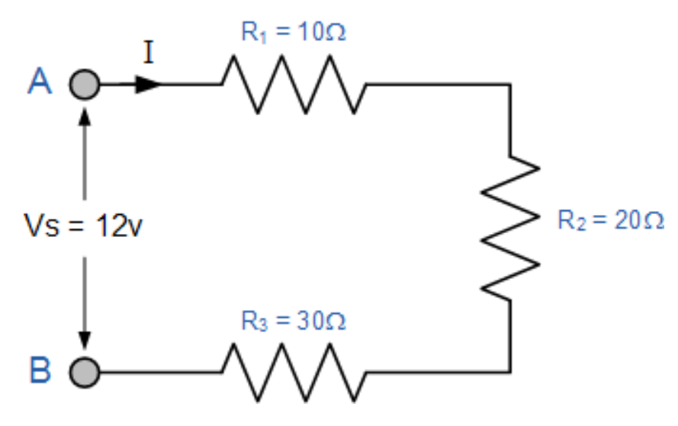
Resistors in series example
Using the formulas above and the laws of omo, calculate the circuits:
Total resistance.
Current flowing in the circuit.
Voltage drop on the resistor.
Total circuit power.

Slide 10
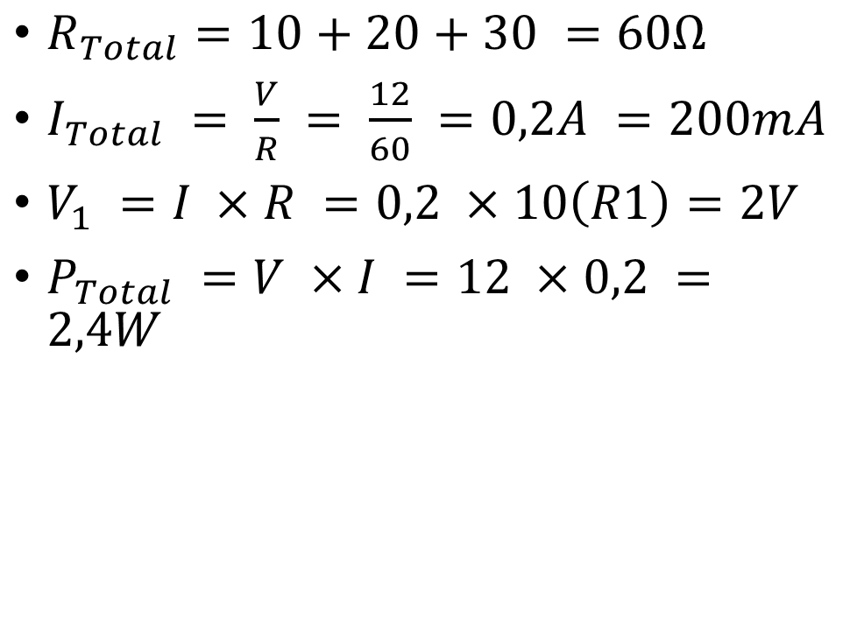
Nuoseklaus jungimo pavyzdys
$R_{Total}=10+20+30 =60Ω$
$I_{Total} = \frac{V}{R} = \frac{12}{60} =0,2A =200mA$
$V_{1} =I ×R =0,2 ×10\left(R1\right)=2V$
$P_{Total} =V ×I =12 ×0,2 =2,4W$

Slide 11
Parallel connection of the resistors
Resistors are connected in parallel when the contacts of all resistors used are connected to two points.
The circuit of the components connected in parallel will have a constant voltage. However, there is more than one path where current can flow, so circuit will have alternating current.

Slide 12
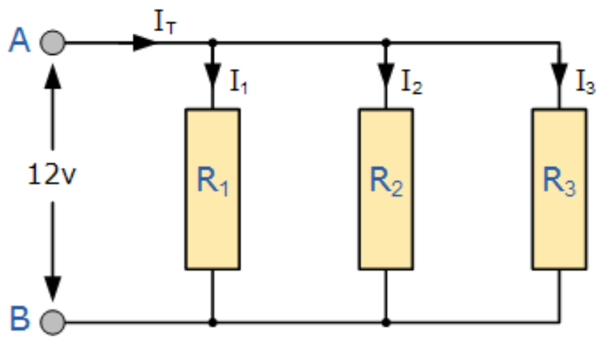

Parallel connection of the resistors
To find the equivalent (total) resistance of a circuit of resistors connected in parallel, we use the following formula :
$\frac{1}{R_{total}} = \frac{1}{R_{1}}+ \frac{1}{R_{2}}+ \frac{1}{R_{3}}+ <…> + \frac{1}{R_{n}}$

Slide 13
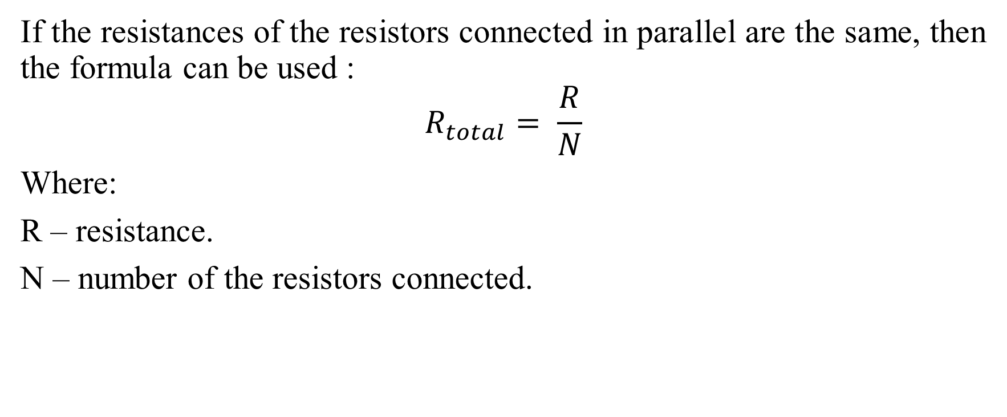
Parallel connection of the resistors
If the resistances of the resistors connected in parallel are the same, then the formula can be used :
$$R_{total}= \frac{R}{N}$$
Where:
R – resistance.
N – number of the resistors connected.

Slide 14
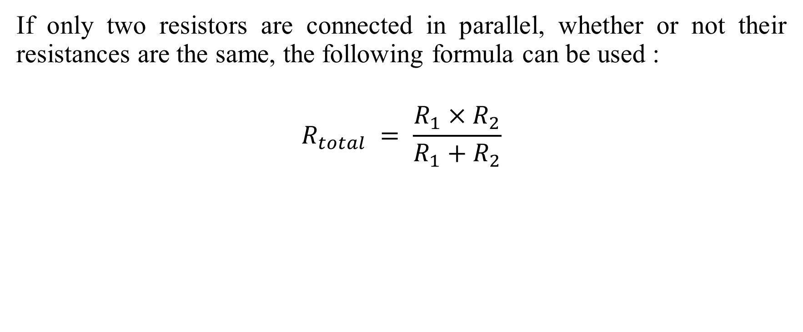
Parallel connection of the resistors
If only two resistors are connected in parallel, whether or not their resistances are the same, the following formula can be used :
$$R_{total} = \frac{R_{1}×R_{2}}{R_{1}+R_{2}}$$

Slide 15
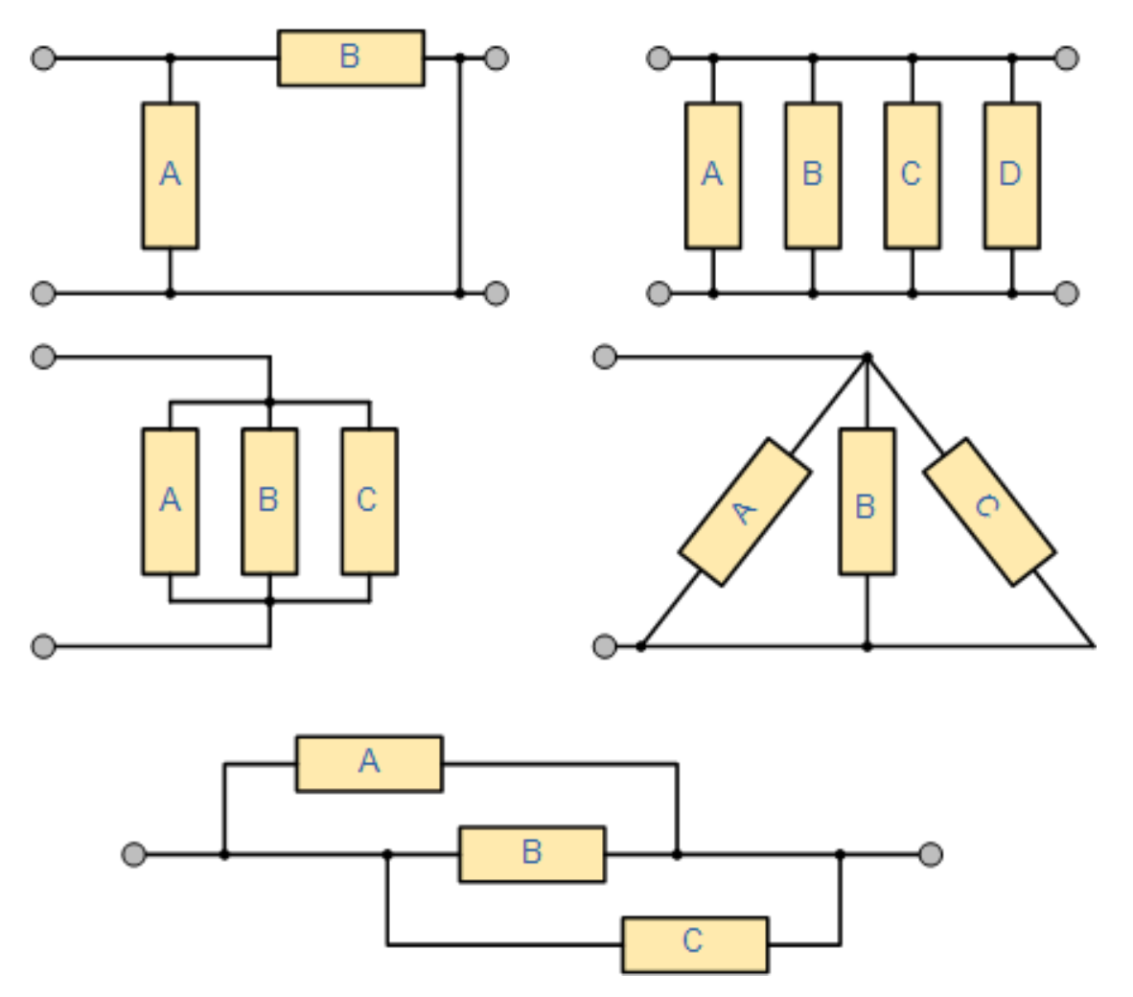
Example of parallel resistors connection

Slide 16
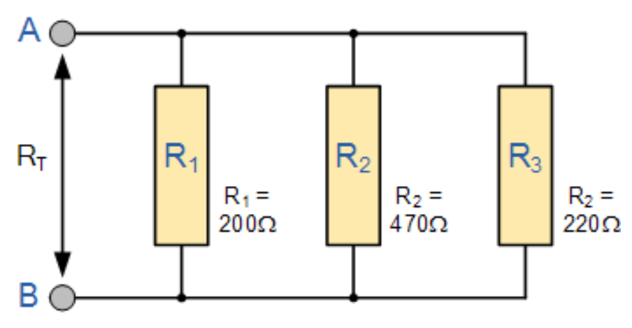
Example of parallel resistors connection
Find the total resistance of the diagram below.

Slide 17

Example of parallel resistors connection
$\frac{1}{R_{total}}=\frac{1}{R_{1}}+ \frac{1}{R_{2}}+ \frac{1}{R_{3}} = \frac{1}{200}+ \frac{1}{470}+ \frac{1}{220} ≈0,0117$
$R_{total} = \frac{1}{0,0117}=85,67Ω$

Slide 18
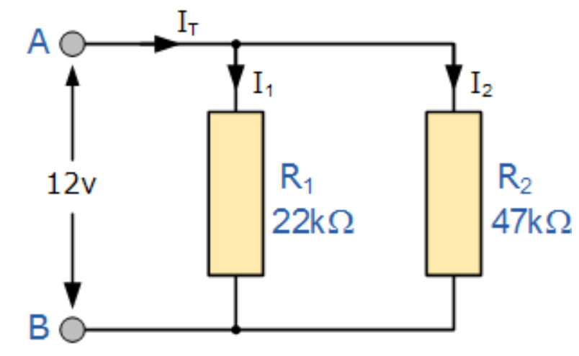
Example of parallel resistors connection
Calculate the total resistance of the given circuit.

Slide 19

Example of parallel resistors connection
$R_{total}=\frac{22000×47000}{22000+47000}=14,985 ≈15kΩ$

Slide 20
Parallel connection of the resistors
Since resistors connected in parallel may have different resistance values, according to the law of ohm, the currents flowing through them will also be different.
They can be calculated using the law of ohm.
The total circuit current can be found either by summing the currents flowing with the resistors, or by having the total circuit voltage and the total resistance, the current can be then calculated according to the ohms law.

Slide 21
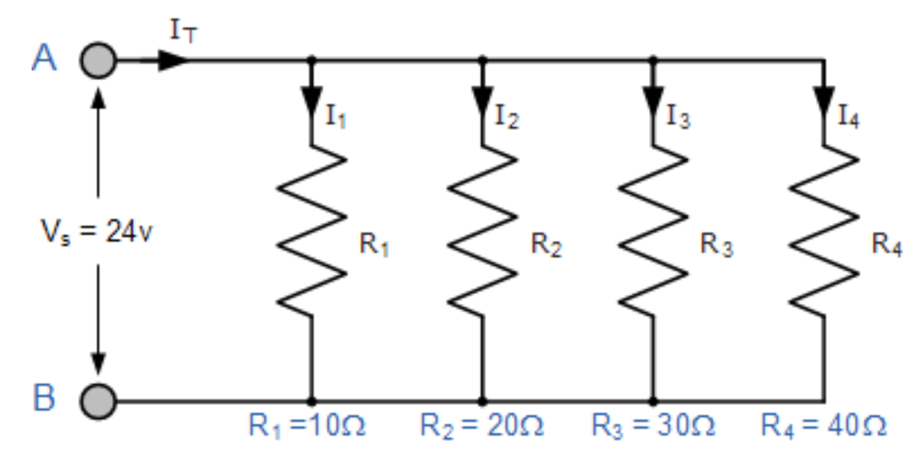
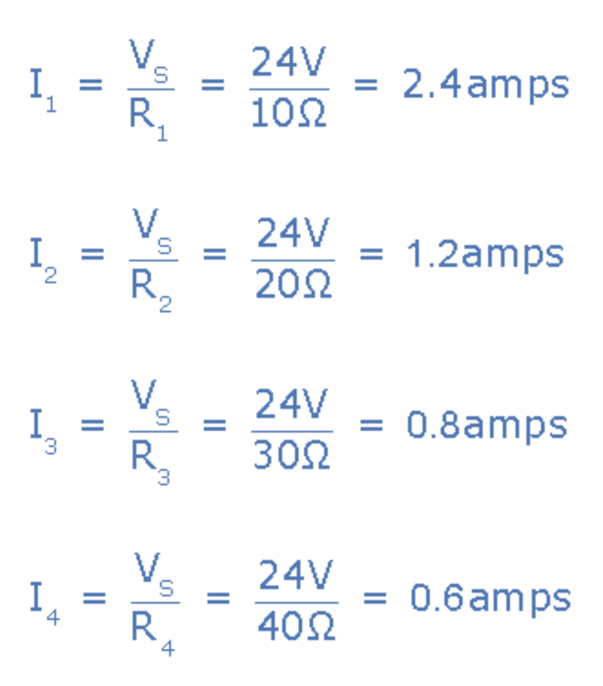
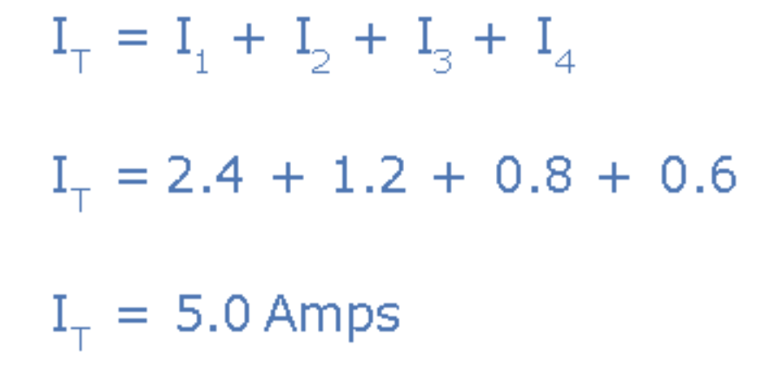
Parallel connection of the resistors

Slide 22
Mixed connection
This happens when both series and parallel connections are used in the circuit.
Such circuits can be quite difficult to deal with.

Slide 23
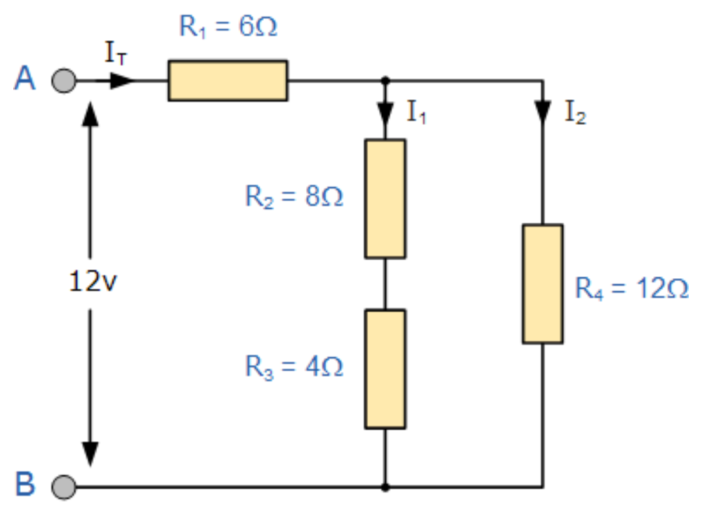
Mixed connection
You need to find the total current that this circuit consumes from a 12 volt power supply.

Slide 24
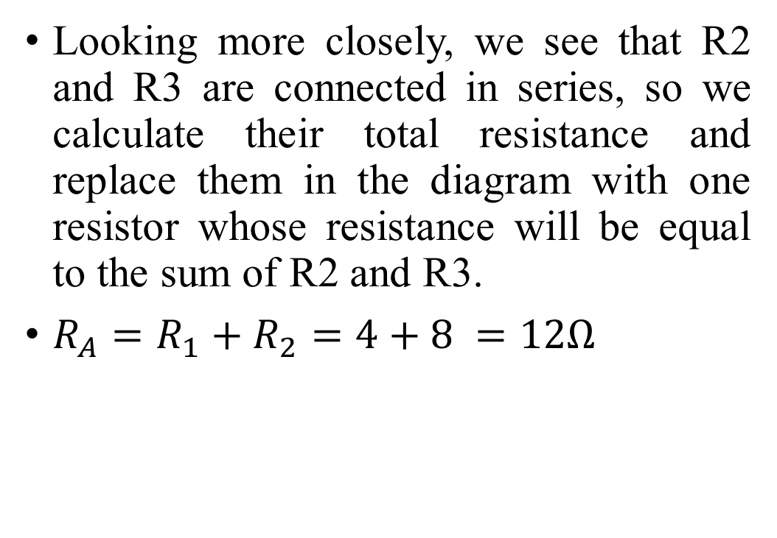
Mixed connection
Looking more closely, we see that R2 and R3 are connected in series, so we calculate their total resistance and replace them in the diagram with one resistor whose resistance will be equal to the sum of R2 and R3.
$R_{A}=R_{1}+R_{2}=4+8 =12Ω$

Slide 25
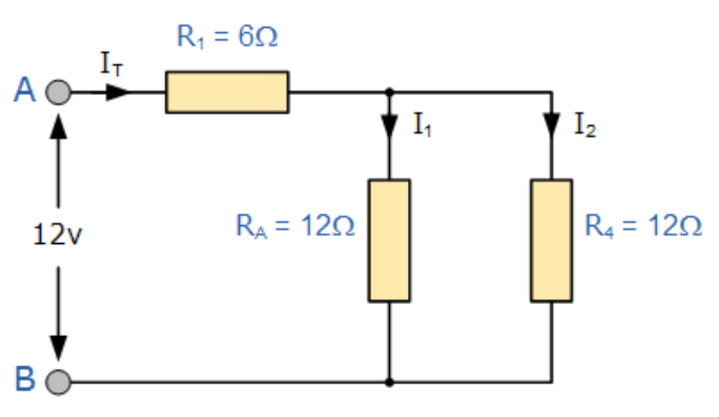
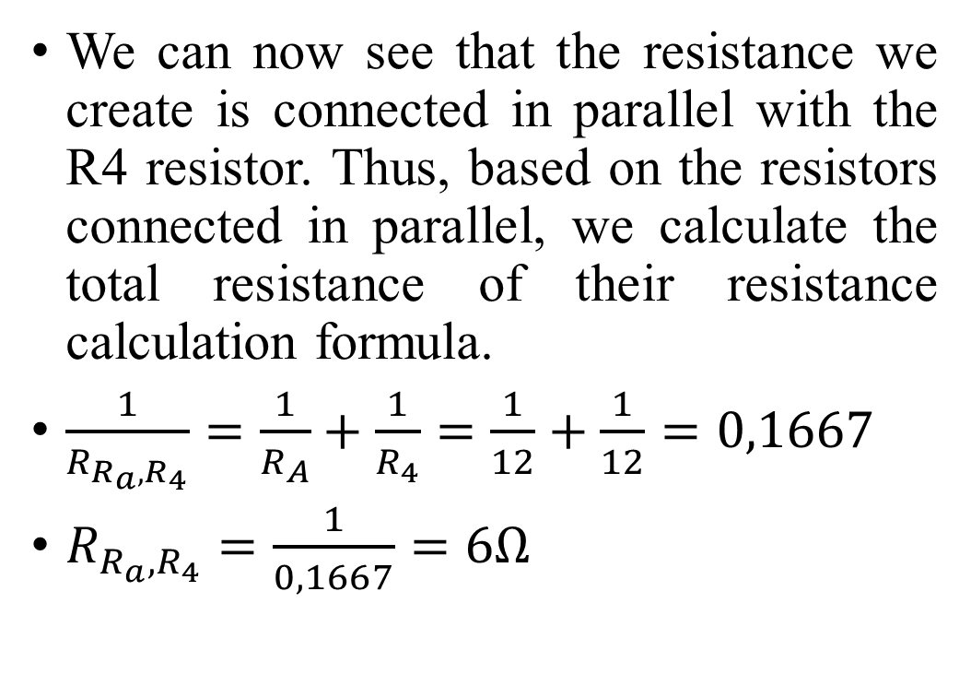
Mixed connection
We can now see that the resistance we create is connected in parallel with the R4 resistor. Thus, based on the resistors connected in parallel, we calculate the total resistance of their resistance calculation formula.
$\frac{1}{R_{R_{a},R_{4}}}=\frac{1}{R_{A}}+\frac{1}{R_{4}}=\frac{1}{12}+\frac{1}{12}=0,1667$
$R_{R_{a},R_{4}}=\frac{1}{0,1667}=6Ω$

Slide 26
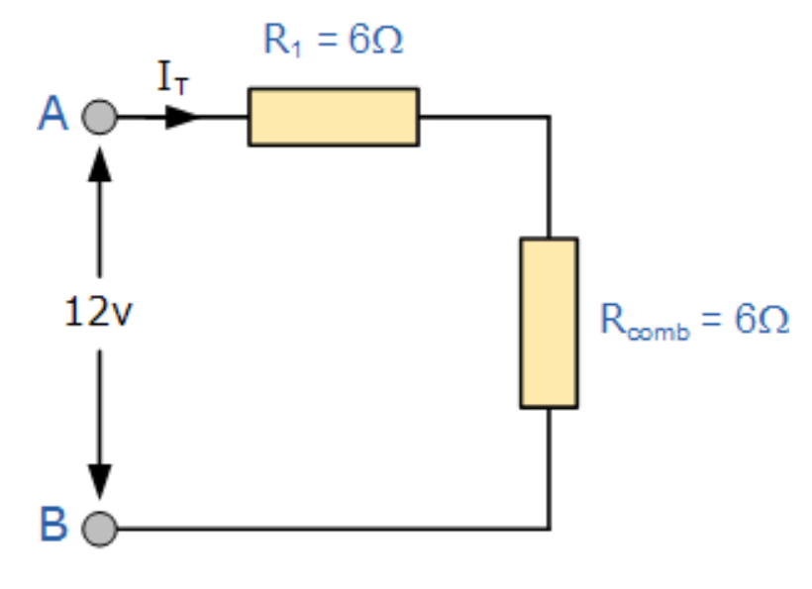
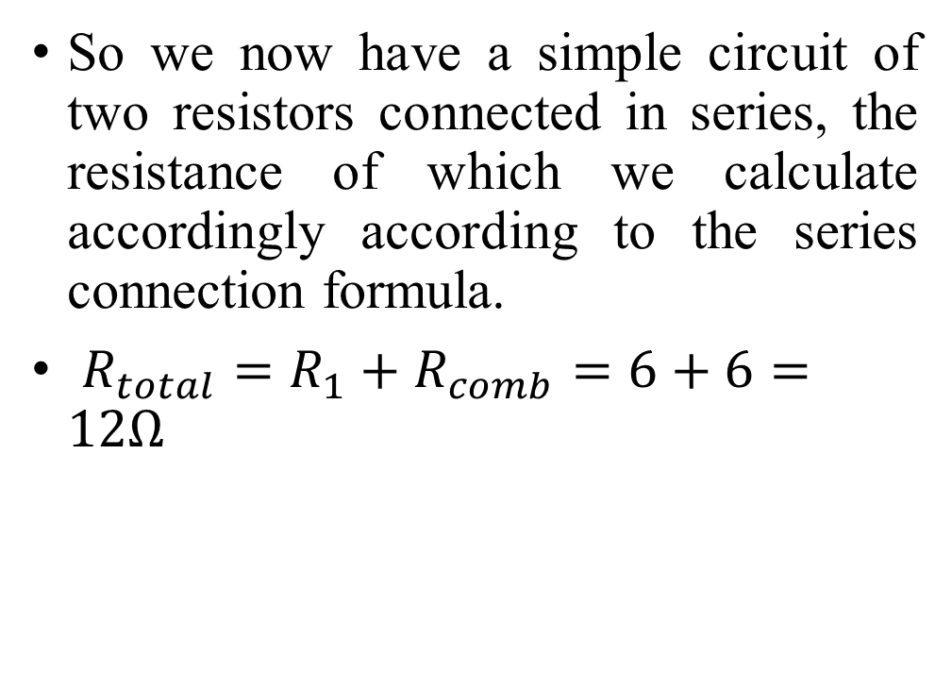
Mixed connection
So we now have a simple circuit of two resistors connected in series, the resistance of which we calculate accordingly according to the series connection formula.
$R_{total}=R_{1}+R_{comb}=6+6=12Ω$

Slide 27
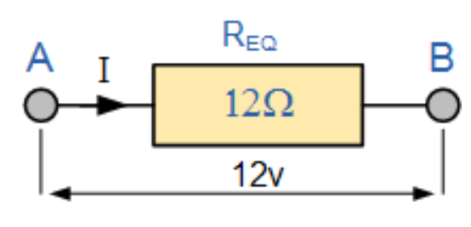

Mixed connection
So now we simply calculate the current on one resistor.
$I=\frac{V}{R}= \frac{12}{12}=1A$

Slide 28
What is a voltage divider?
Voltage divider is a series circuit of connected resistors with different voltage drops on each resistor.
As mentioned in previous lectures, this is essentially a potentiometer, simply assembled from several individual components.

Slide 29
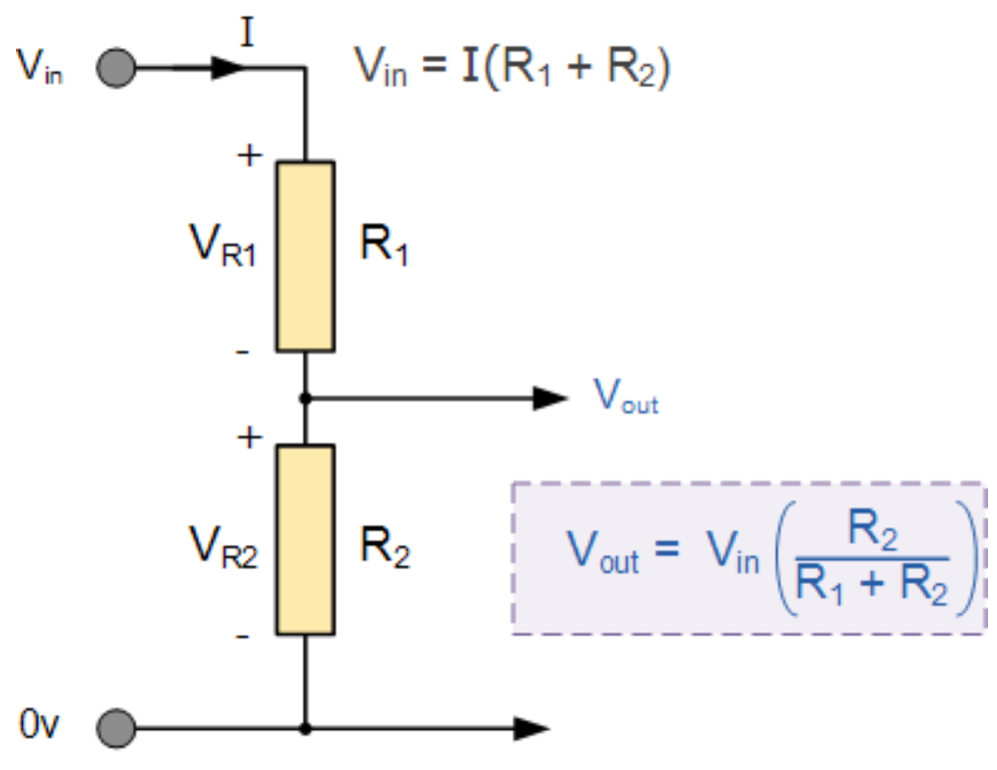
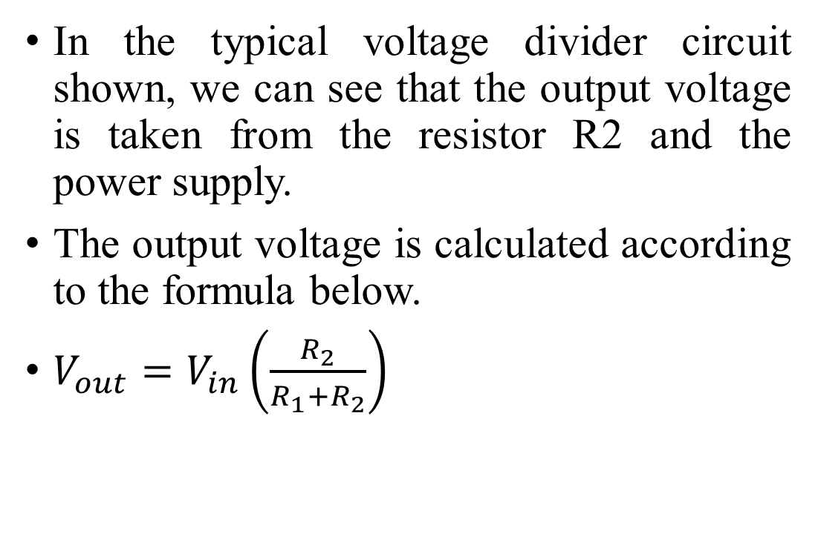
What is a voltage divider?
In the typical voltage divider circuit shown, we can see that the output voltage is taken from the resistor R2 and the power supply.
The output voltage is calculated according to the formula below.
$V_{out}=V_{in}\left(\frac{R_{2}}{R_{1}+R_{2}}\right)$

Slide 30
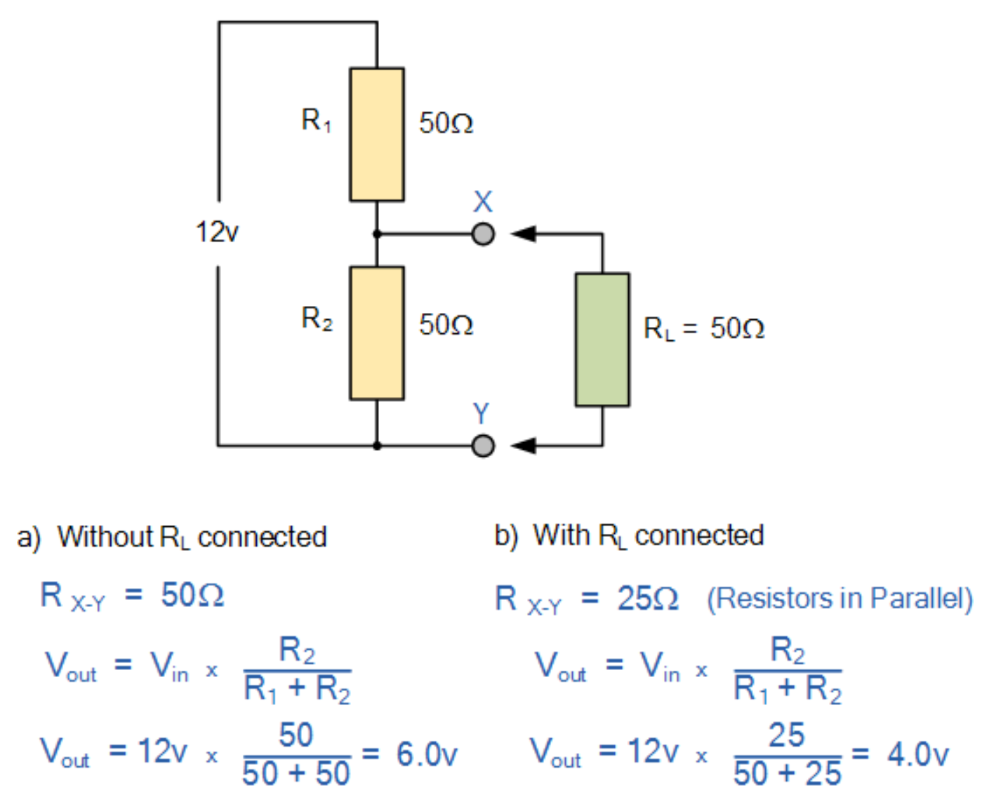
What is a voltage divider?
As we can see from the given example, when another resistor is connected to the voltage divider circuit as a load, the voltage drop decreases.
The higher the load resistance we connect, the more the voltage drop will decrease.

Slide 31
What is a voltage divider?
Voltage dividers are used in many places, but the most obvious example is sensors.
For example, the simplest light level sensor can be made using a voltage divider circuit in which a photoresistor is connected instead of a load resistor, the resistance of which varies depending on how much light falls on it.

Slide 32
Goodbye

